Slide 2
Introducing...Kudos
Packed with tools and information to help students make better choices about options for post 16, 18 and their future careers

Slide 3
Let’s Start With The Basics...

Slide 4
Getting started
Start by going to: https://www.cascaid.co.uk/
Click log in (top right corner) and choose Kudos

Slide 5
This Is Your Login Page
Your username is your school email address
Password is: password
It will then prompt you to change this

Slide 6
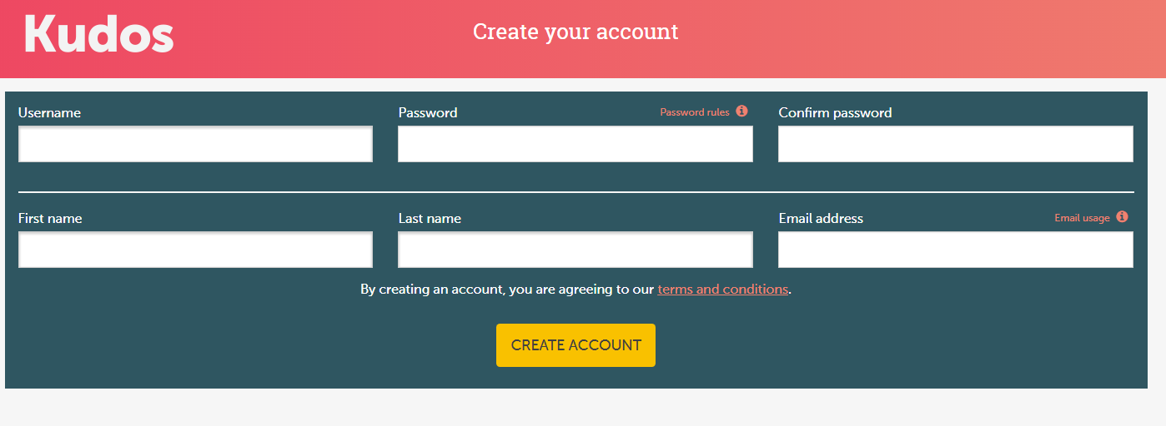
New Users Create Your Account Here

Slide 7
New Users Tell Us A Little About Yourself
Please fill in this information and select your year group under Kudos group.
Where it says “what qualification level do you hope to achieve, select “degree level”. It doesn’t matter if this is true or not; it just stops it from filtering out degree level jobs you might be interested in

Slide 8
Now That You’re Set Up...

Slide 9
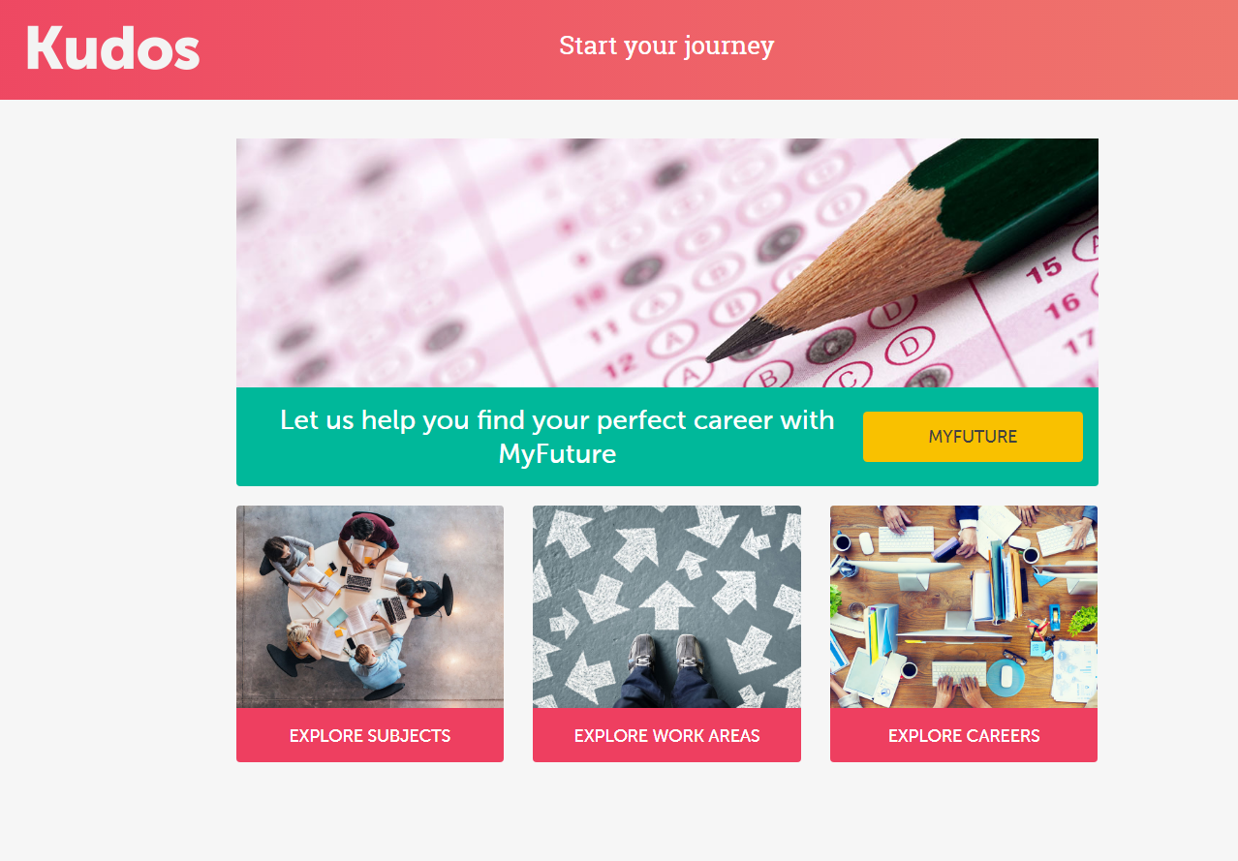
Start Your Journey Here
The fun bit is clicking on “my future”; this takes you to the first 60 questions about your likes and dislikes

Slide 10
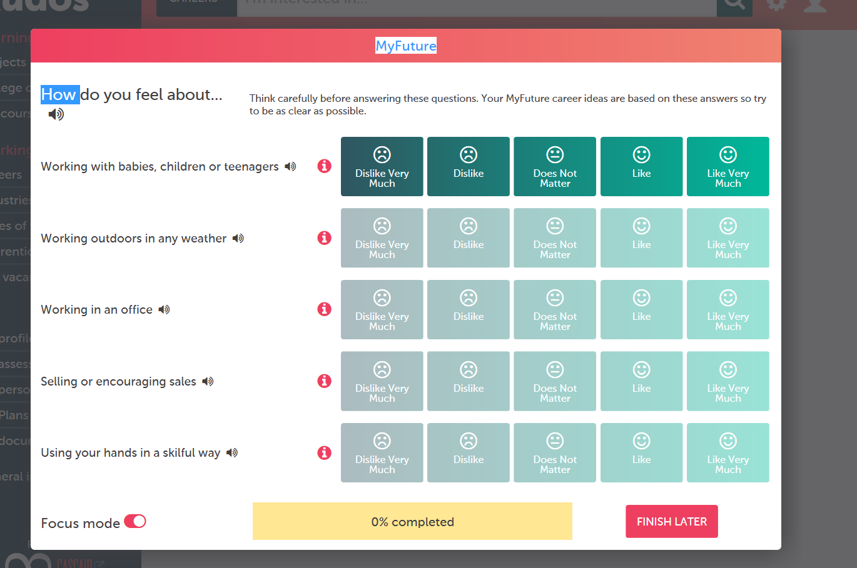
Answer these as honestly as you can.
You can click “focus mode” so it only gives you one question at a time if the number on screen feels overwhelming.
You can always click “finish later” for a break as well
Complete The MyFuture Quiz

Slide 11
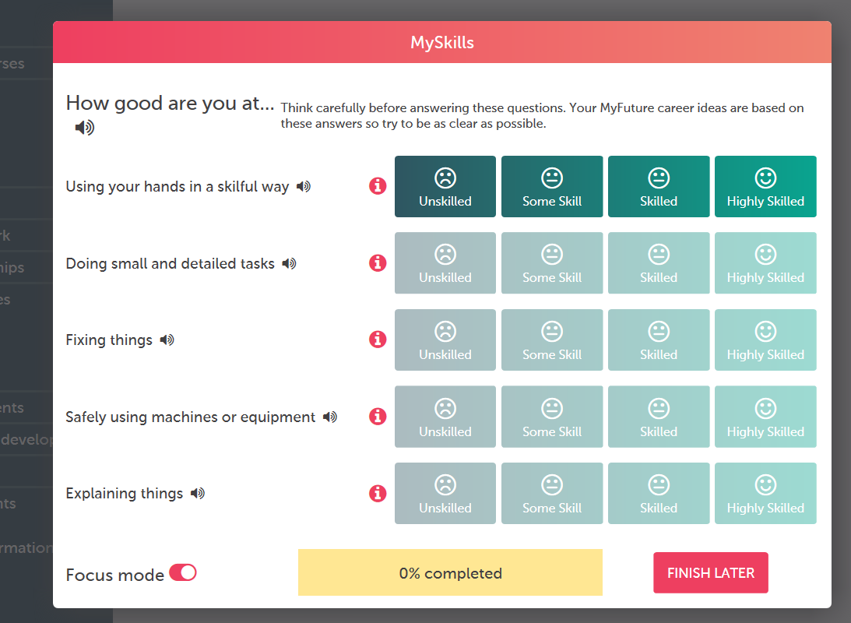
Only doing the first set of questions can sometimes give some odd results, so its good to do the other questions in the “my skills” quiz as well
Your job suggestions will be much more accurate after doing these.
Complete The MySkills Quiz

Slide 12
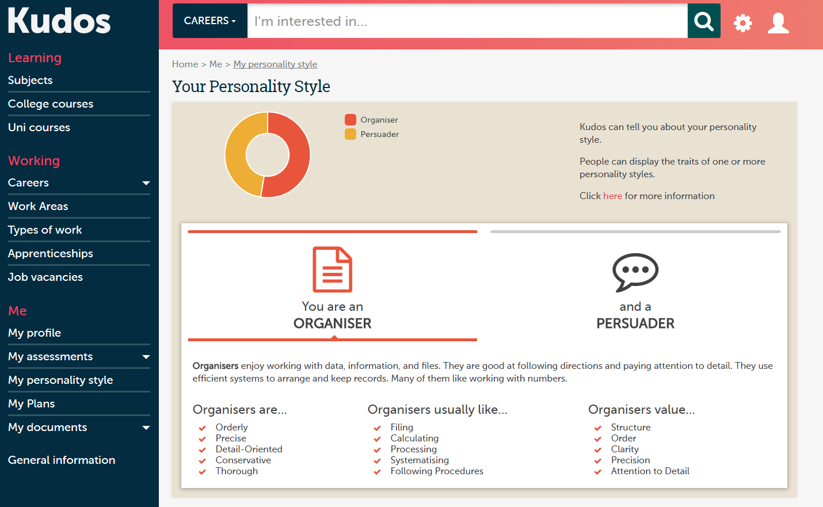
This section breaks down your answers to suggest the kinds of person you are and the kinds of things you are particularly good at
This helps you understand the types of career that suit your personality
Explore Your Personality Style

Slide 13
Start Exploring Career Pathways...

Slide 14
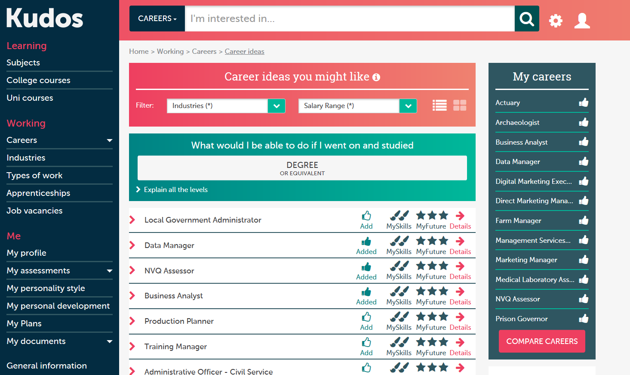
This is the career suggestions based on your answers, ranked according to suitability.
Click on one and it will show you what you said that makes you so suitable for it
Career Ideas

Slide 15
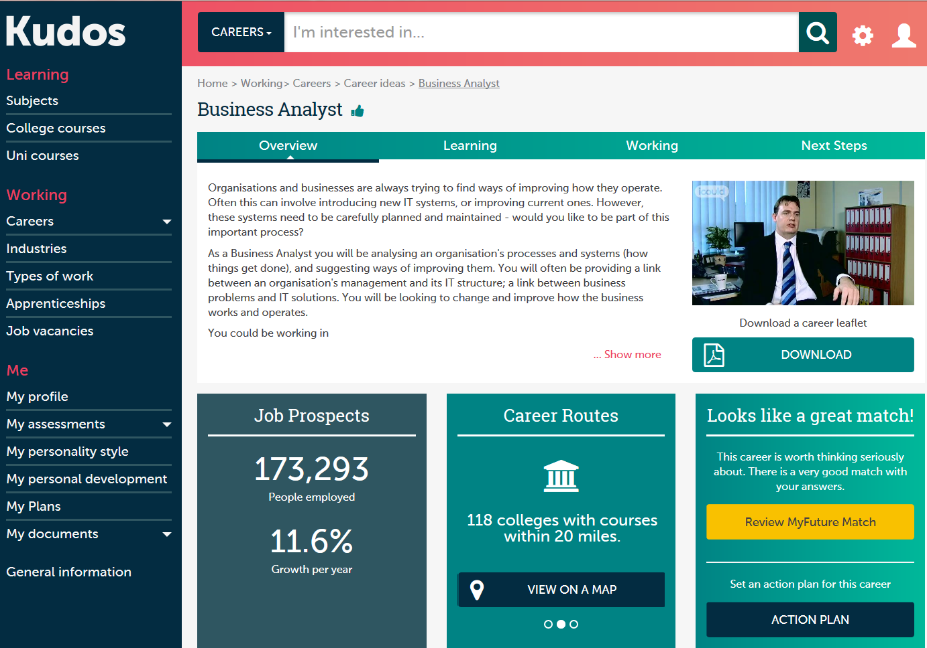
Click on one of these choices and it will tell you all sorts of information; including college and university courses that would lead to that career, the hours, the pay, and what the job looks like day to day.
Career Information

Slide 16
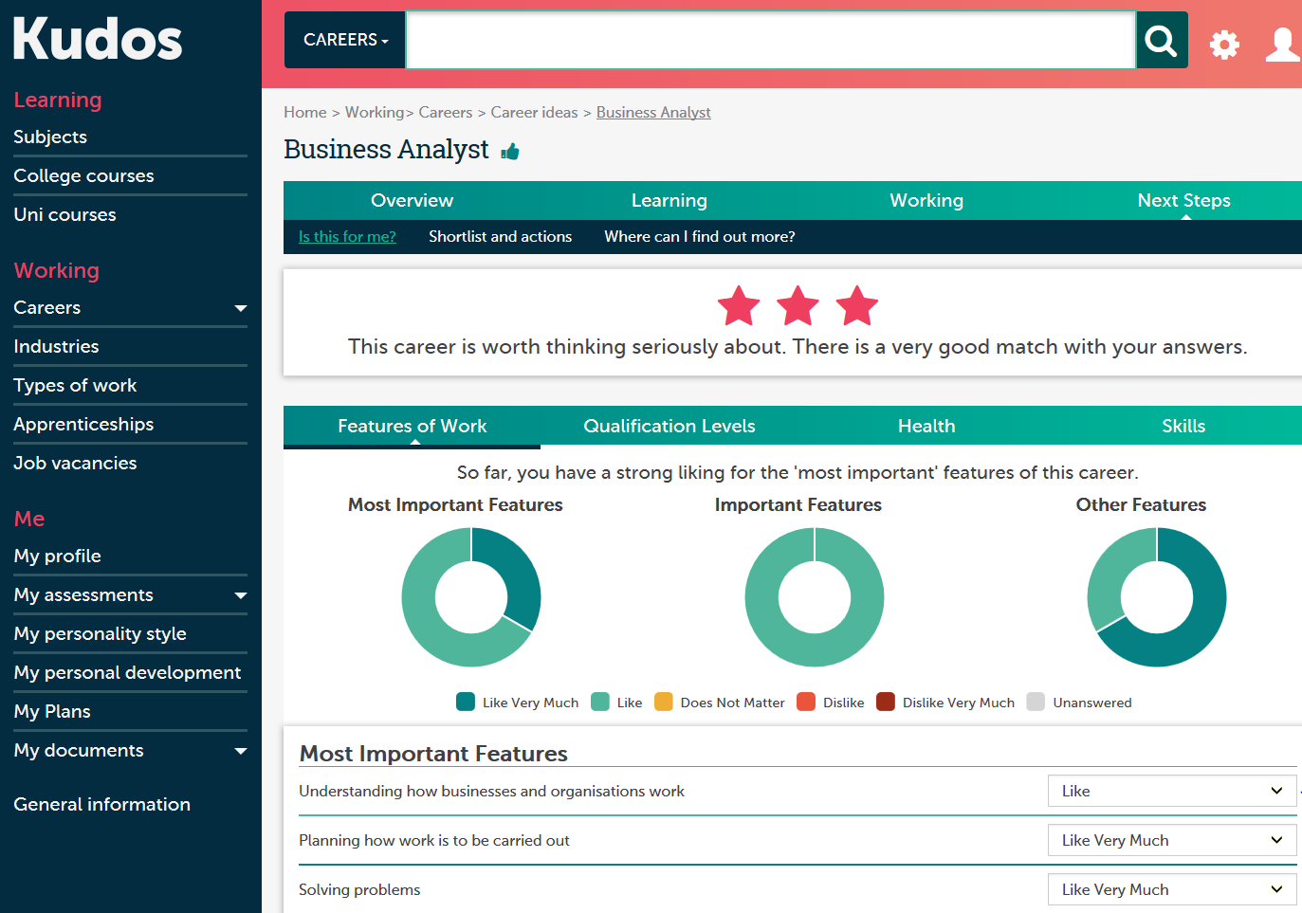
In this section, you can look at what makes a job particularly suited (or not suited) to you.
It highlights the most important questions linked with it and how you answered, so you can see the features that are most important
Review MyFuture Match

Slide 17
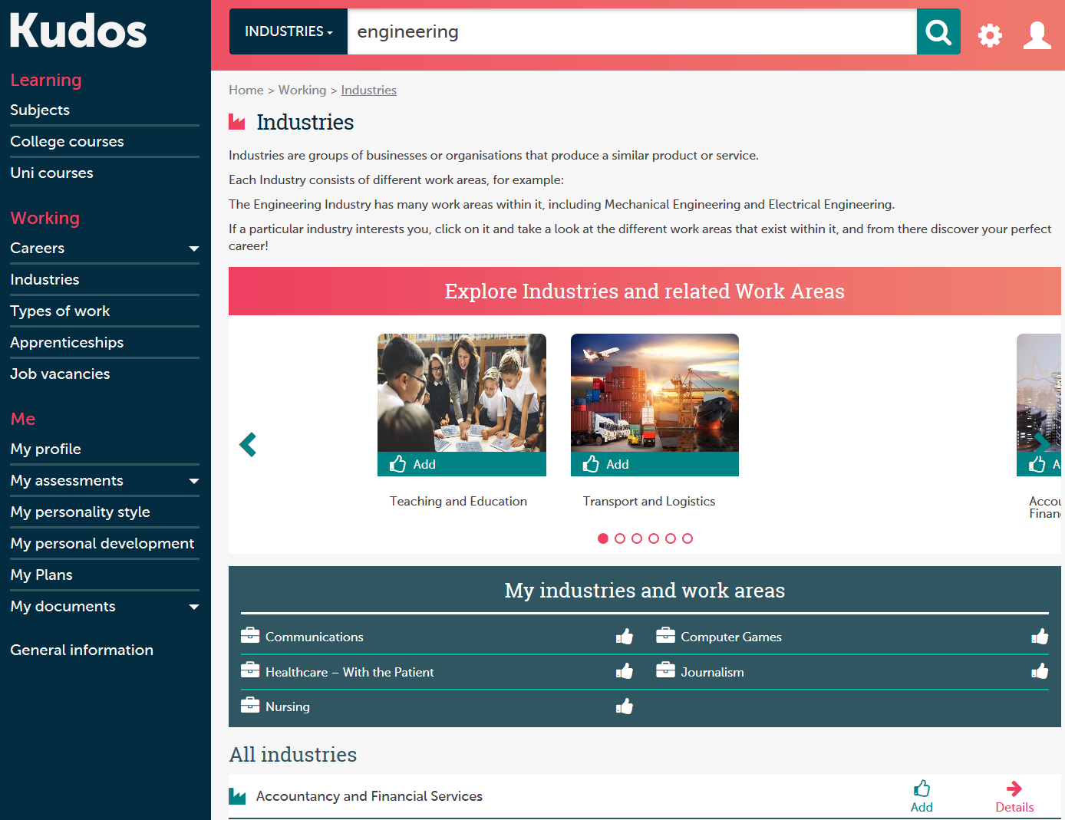
This section allows you to explore specific industries, such as engineering, computing, scientific research, medicine etc.
It is incredibly useful as it will list the huge variety of jobs available in those industries.
So if you want to do something in medicine but not be a doctor, it will help you see what else us out there
Explore Industries

Slide 18
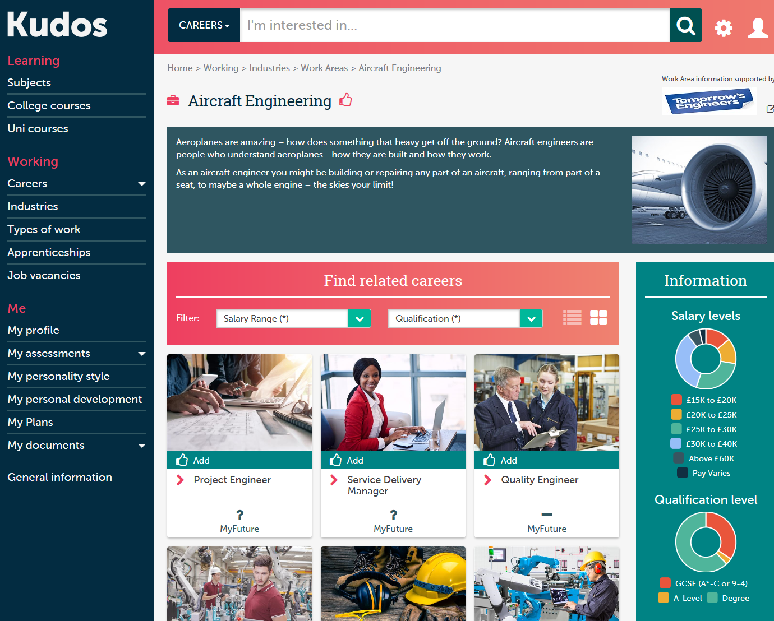
Explore Work Areas
You can also explore detailed information about individual careers and work areas.
Each page will have a video of someone in that job describing it and a wealth of information.
You can save favourite jobs to your profile.

Slide 19
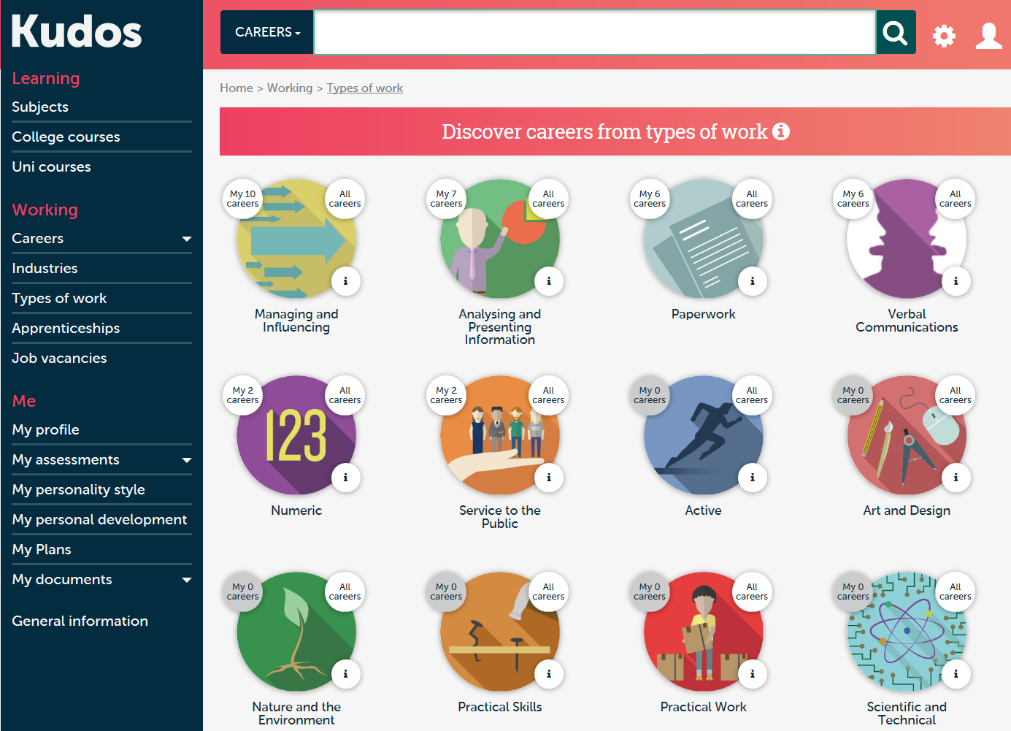
Discover Careers From Types of Work
In the Types of Work section, you will see sections split into different areas; jobs involving leadership, jobs involving numbers, etc.
It will tell you how many of these types of jobs match your own profile, so you can see types of work that would suit you

Slide 20
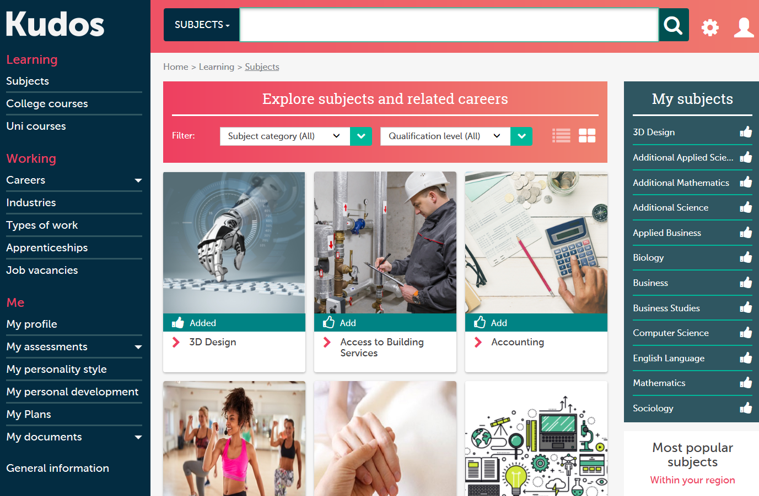
This section allows you to explore in detail different subjects and the careers they can lead to.
Very useful for anyone applying to university, choosing A Levels or choosing GCSEs.
Explore Subjects

Slide 21
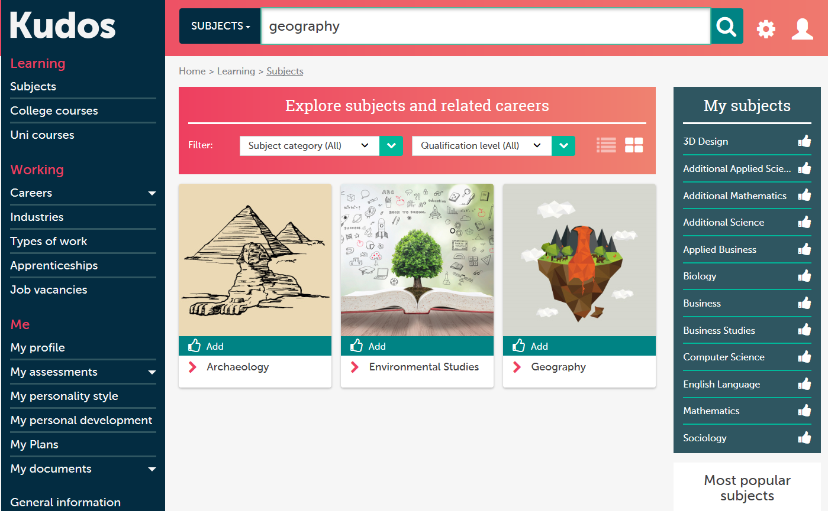
Explore How Subjects Are Related to Careers

Slide 22
Further Or Higher Education?

Slide 23
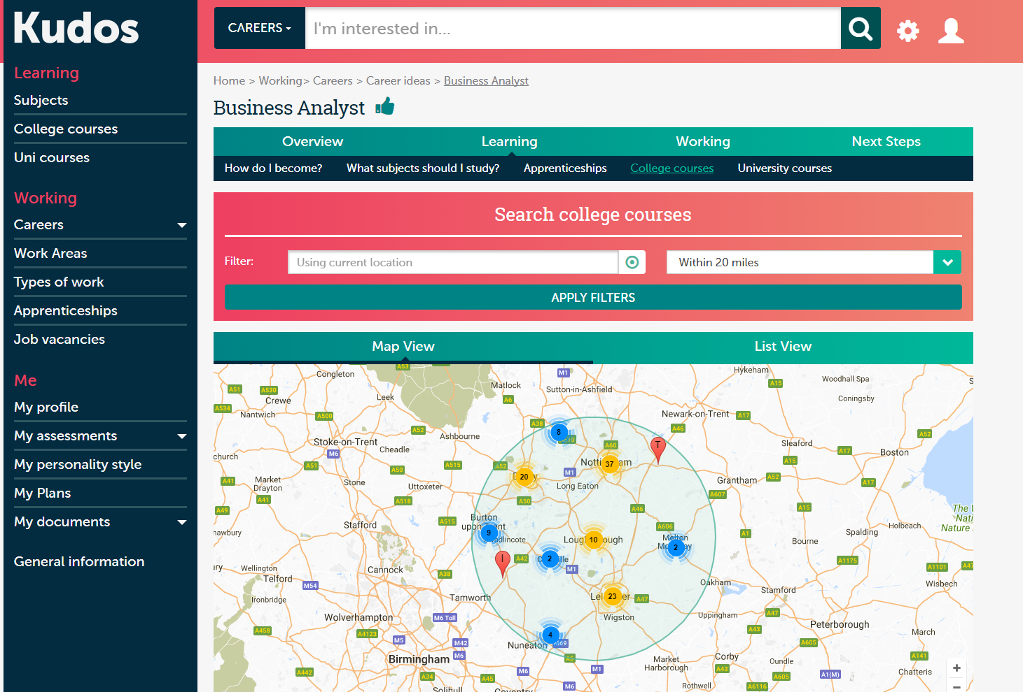
Explore College Courses Related To A Career
With this tool you can find college courses local to you that link to the careers that have matched your profile

Slide 24
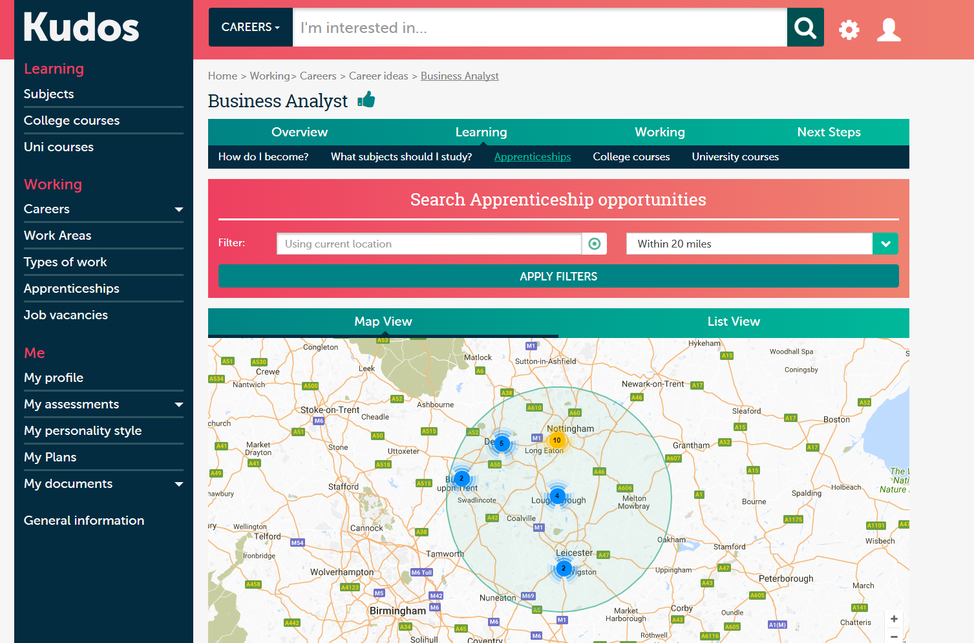
You can also find apprenticeships locally that match your job suggestions
Explore Apprenticeships

Slide 25
…and university courses
Discover University Courses

Slide 26
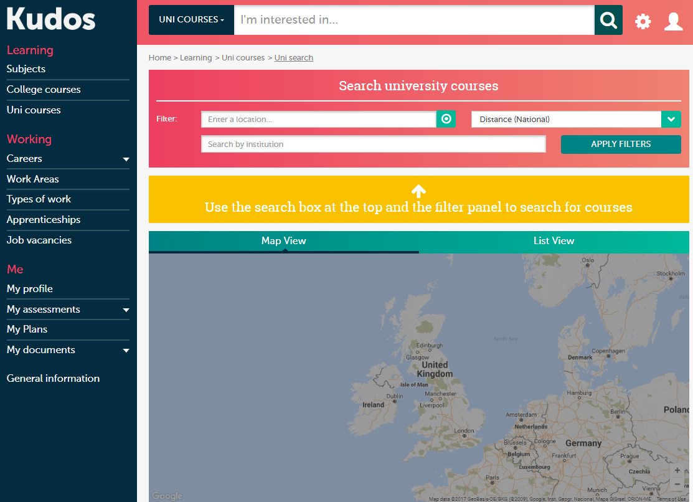
Full UCAS Search
Just like with Unifrog, you can do a full university course search through KUDOS

Slide 27
Reflect And Plan For Your Future

Slide 28
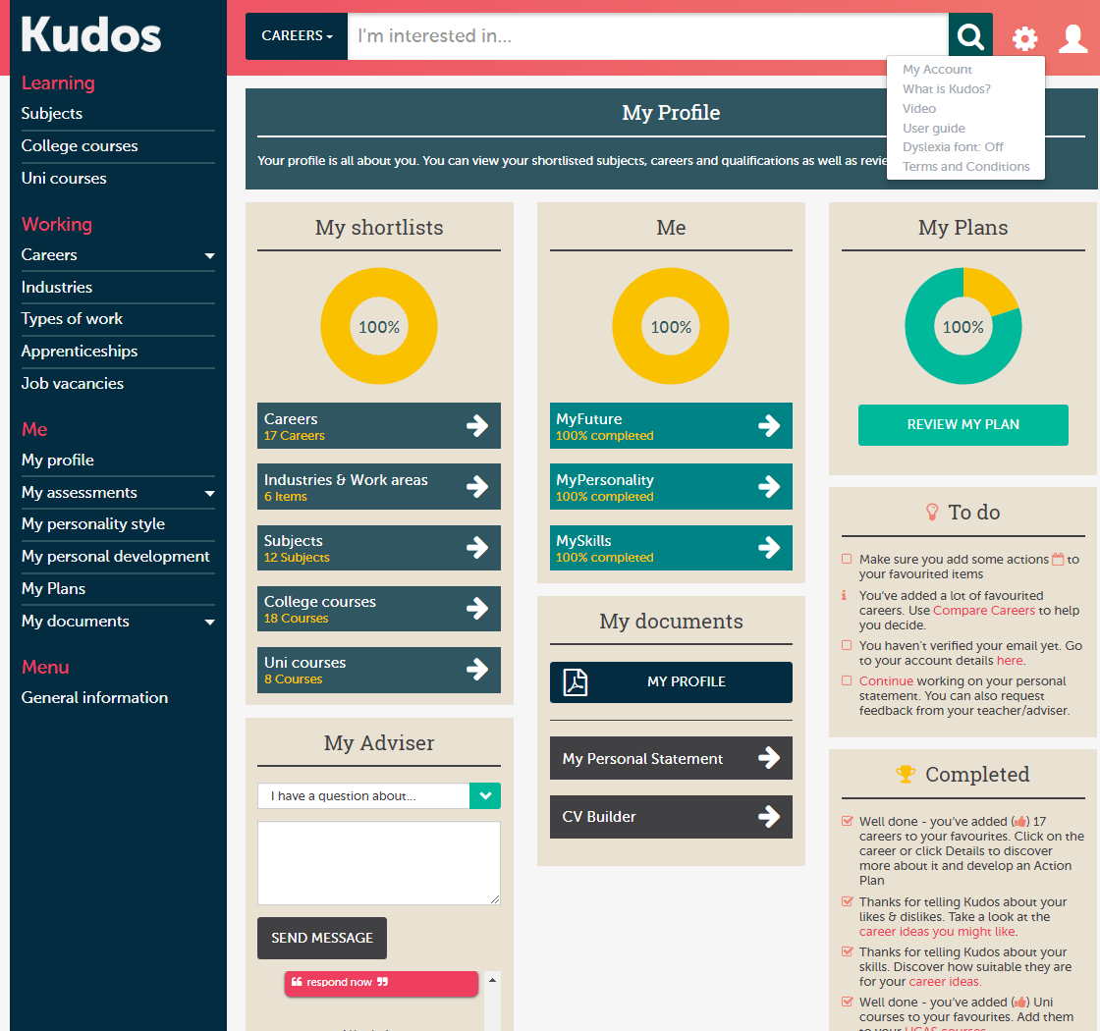
Visit Your Profile
Your profile is a really useful tool; you can see your shortlists, your suggestions and build an action plan.

Slide 29
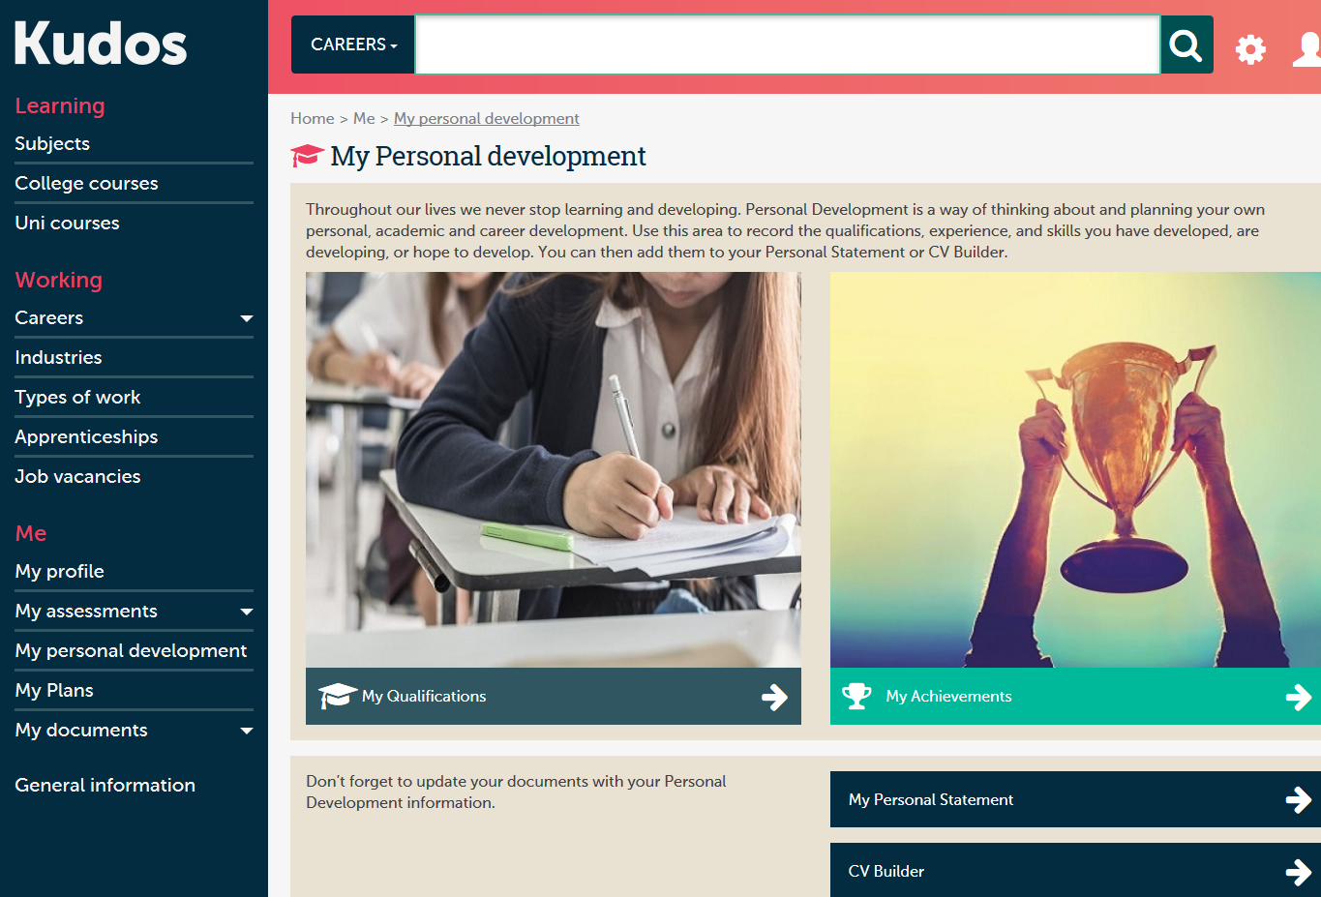
Log your achievements and qualifications
You can log your achievements on Kudos as well; things like D of E, UKMT etc

Slide 30
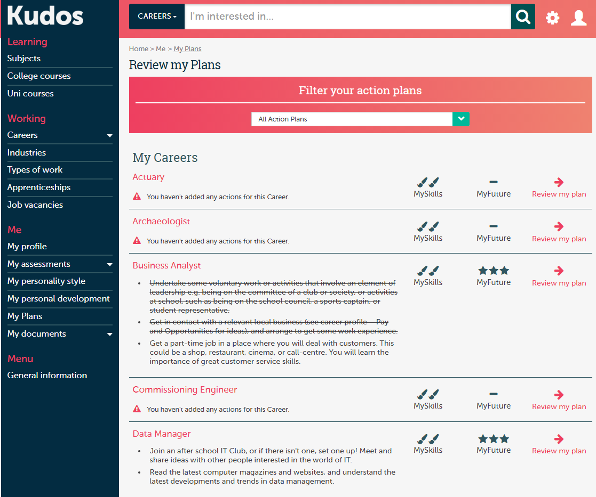
Review Your Plans
You can create action plans related to each of the careers you have favourited

Slide 31
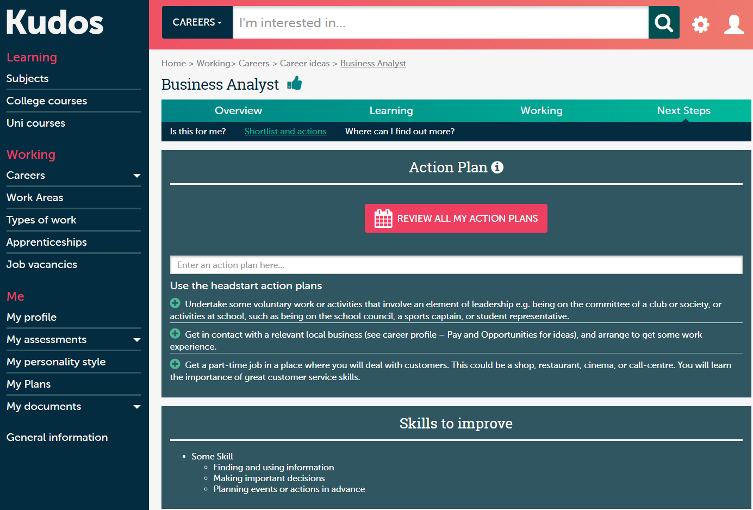
Create Action Plans

Slide 32
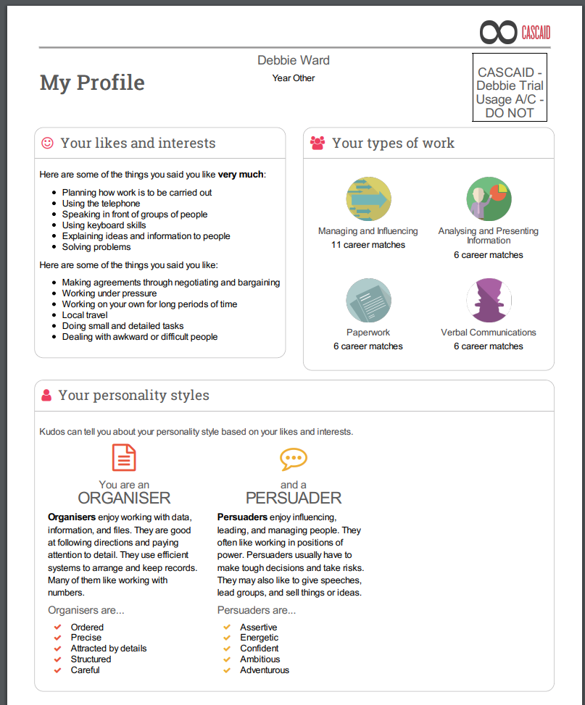
You can create a complete profile of yourself, including your likes and dislikes, your skills and the types of job most suited to you.
This can then be printed and shown to your parents and tutors
Print Out Your Profile

Slide 33
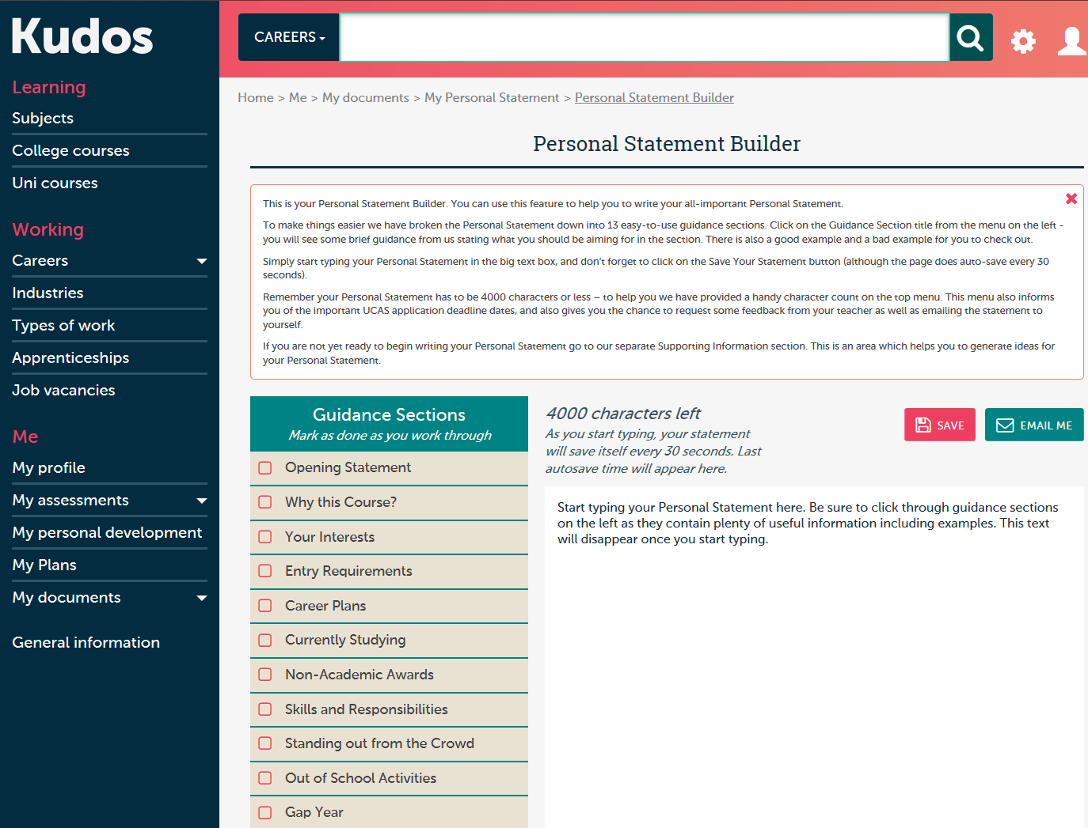
Review And Build Your Personal Statement
We will still use Unifrog as our main personal statement platform, but Kudos can do this too. It has several sections that give suggestions, and in terms of building a personal statement is possibly more helpful

Slide 34
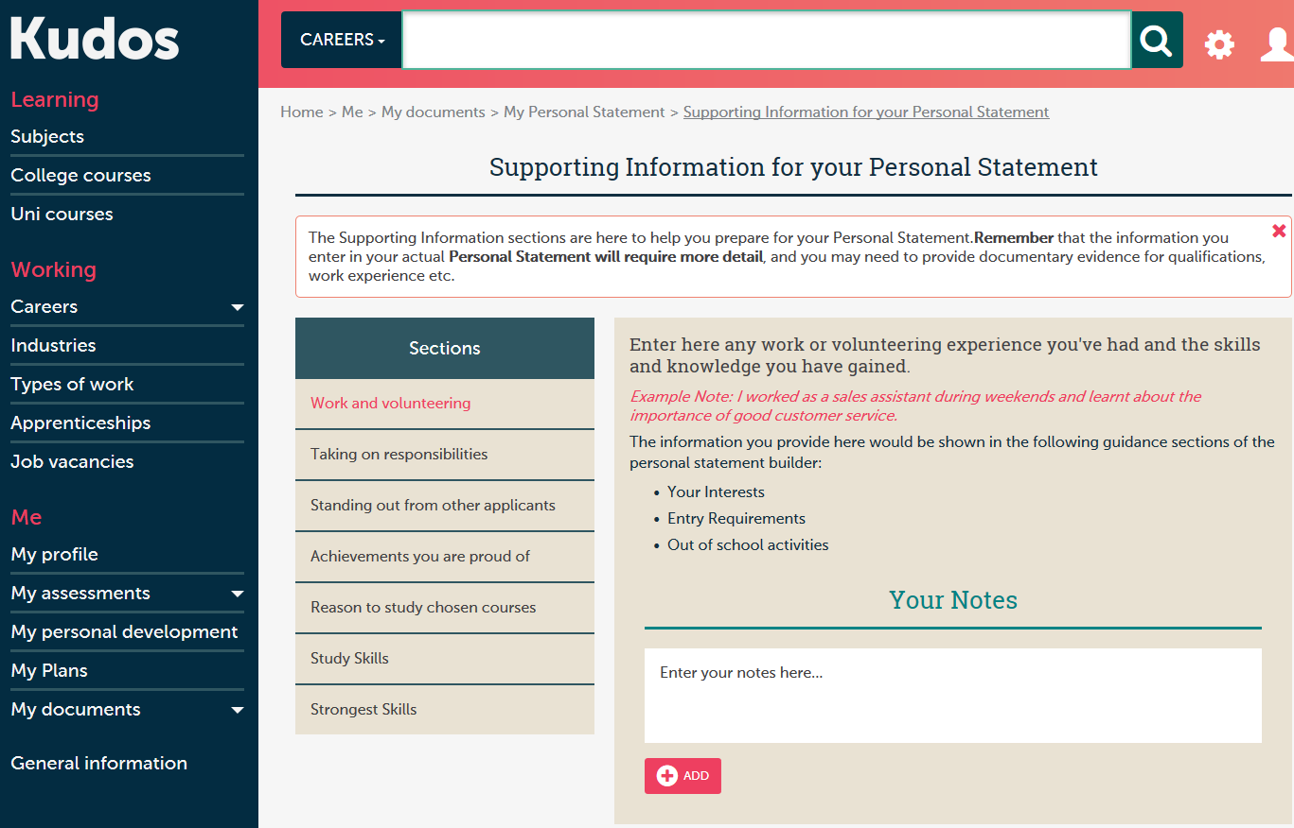
Review Your Supporting Information

Slide 35
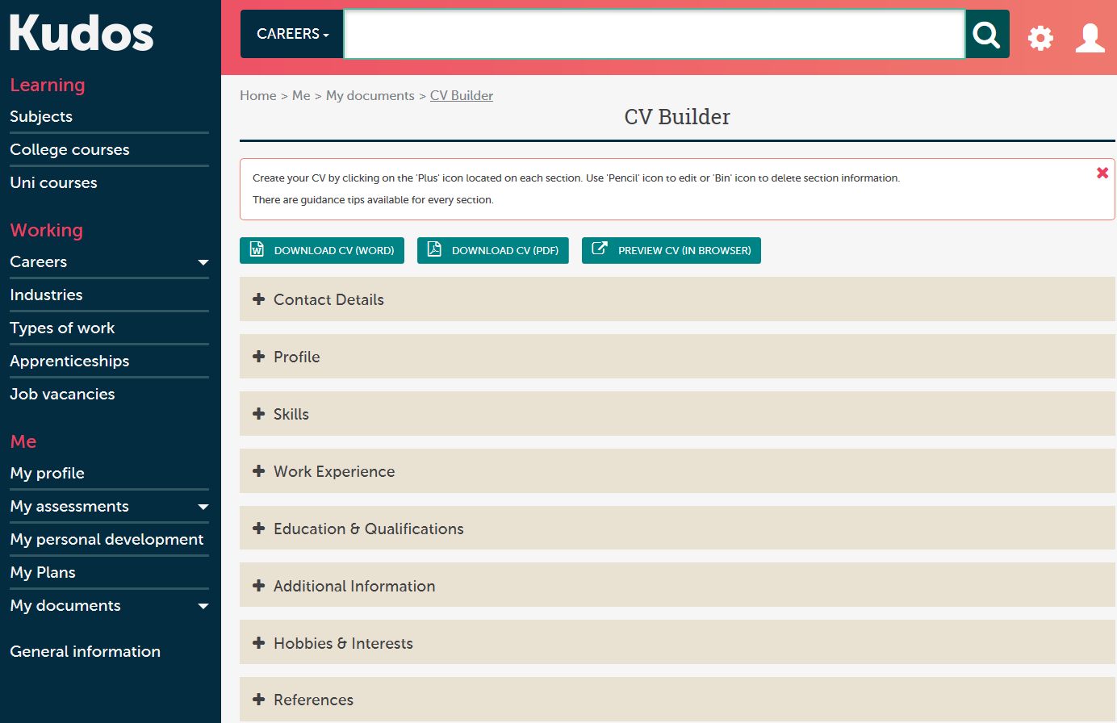
You can also use Kudos to build your CV, which is really easy and really useful.
Explore the CV Builder

Slide 36
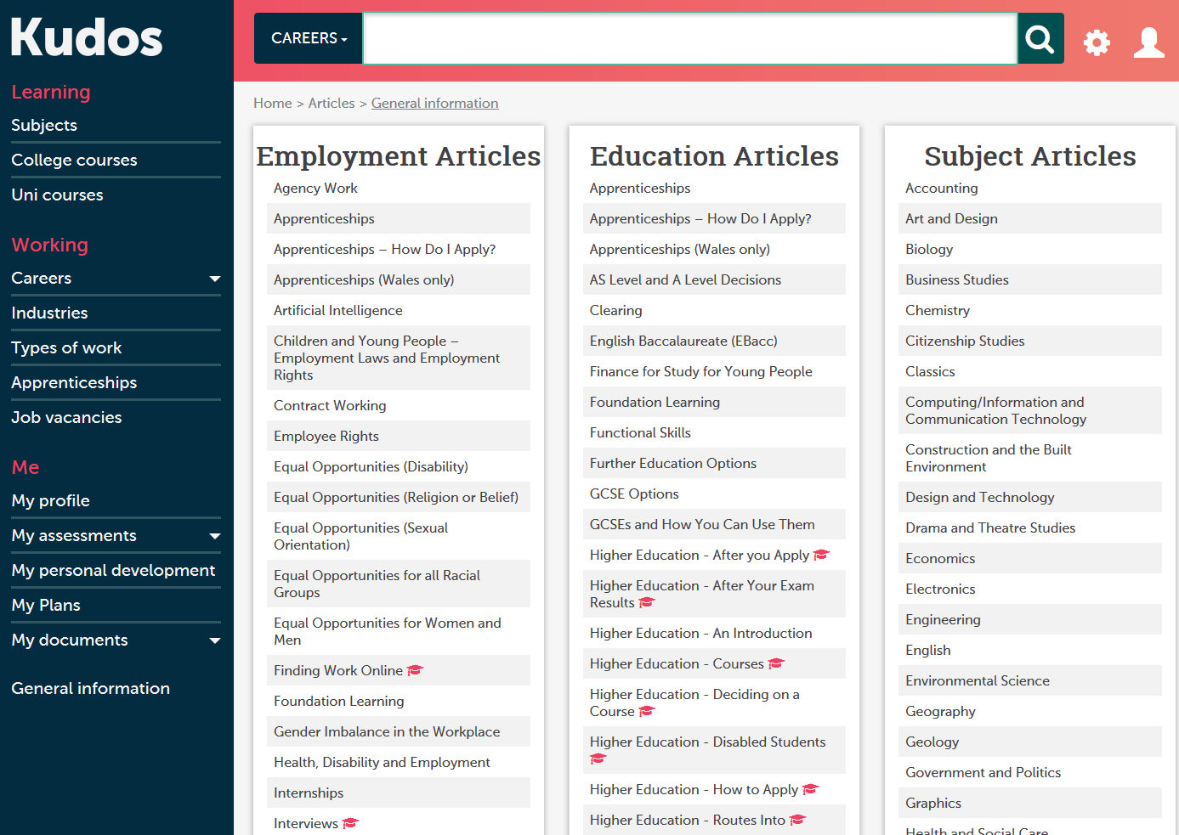
Don’t Forget To Check Out General Information
Finally, the general information section has dozens of up to date articles on jobs, subjects and courses.

Slide 37
Thank You For Your Time

