Slide 1
Welcome to A level Maths @

Slide 2
Why study Mathematics A levels?
Studying Mathematics will:
provide a stimulating and challenging course;
develop key employability skills such as problem-solving, logical reasoning, communication and resilience;
increase knowledge and understanding of mathematical techniques and their applications;
support the study of other A level subjects;
provide excellent preparation for a wide range of university courses;
lead to a versatile qualification that is well-respected by employers and higher education.

Slide 3
What is covered in AS/A level Mathematics?
All of the content in the AS/A level Mathematics qualification is compulsory and is the same for all examination boards.
Pure (or Core) Mathematics (66%)
methods and techniques which underpin the study of all other areas of mathematics such as, proof, algebra, trigonometry, calculus, and vectors.
Statistics (17%)
statistical sampling, data analysis and representation and probability leading to the study of statistical distributions
Mechanics (17%)
the study of the physical world, modelling the motion of objects and the forces acting on them.
Our exam board is Edexcel

Slide 4
We asked year 12 what advice they would give to someone thinking about studying A level maths – they said:
It’s a big step up from maths at GCSE
There is a lot of algebra and you need to understand mathematical concepts, as well as being able to use them.
You need to be prepared for constant hard work. ASK QUESTIONS.
You have to have a positive,
strong minded mind set.
Make sure you like maths
Ensure you have the academic ability to cope
It’s not a course you can just pass through, you have to persevere and be patient .
Consider if you enjoy the last question on a GCSE paper.
If not, DO NOT TAKE A LEVEL MATHS
Keep revising from the beginning.
Sort any problems out before it is too late.
Don’t expect the work you do in class to be enough

Slide 5
Find the coordinates of the 8 points labelled A - H
Extension question:
How does the problem change if the equation of the line becomes:
$y=4x−18$
$y=4x−14.5$?

Slide 6
Find the coordinates of the 8 points labelled A - H
Click on the link below to take you to an interactive graph plotter for these functions
Extension question:
How does the problem change if the equation of the line becomes:
$y=4x−18$
$y=4x−14.5$?
https://www.desmos.com/calculator/oacv5ngszy

Slide 7
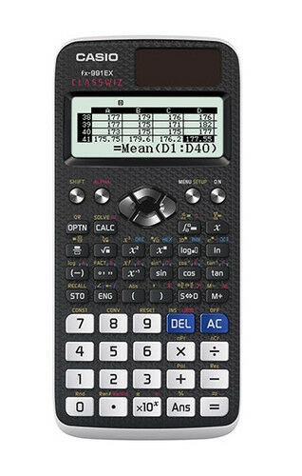
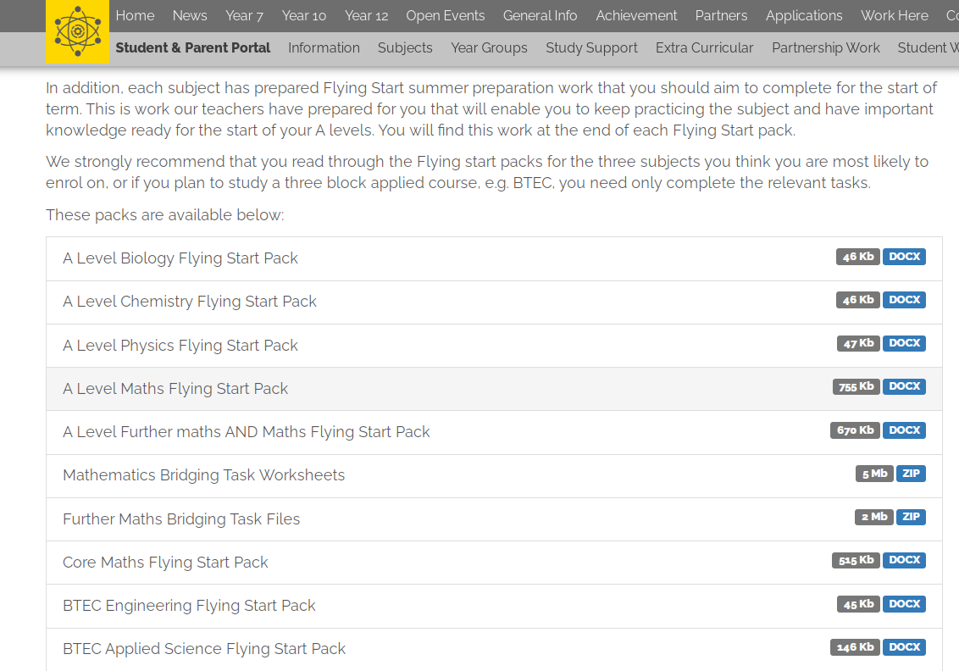
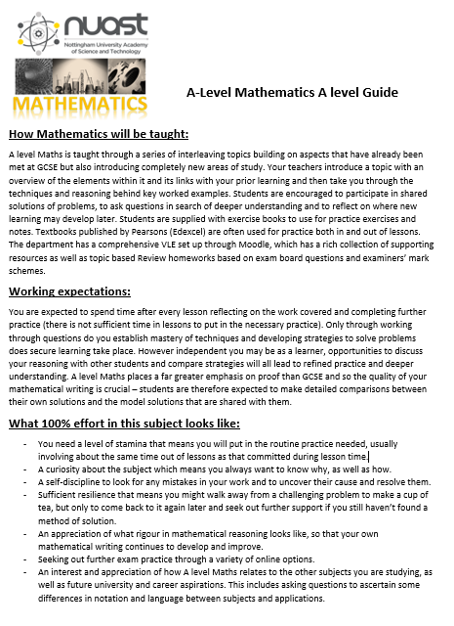
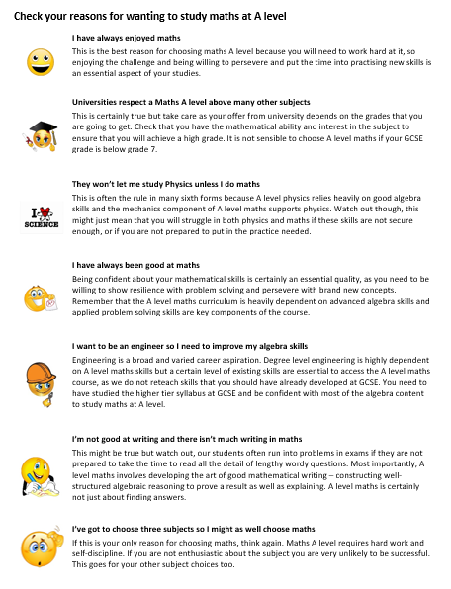
If you are now missing maths too much and want some more to think about, take a look at the problem below:
Casio Classwiz calculator for A level fx991EX
Flying start
NUAST website files
Supporting revision from GCSE Higher tier
A good affordable calculator for A level

