Slide 1
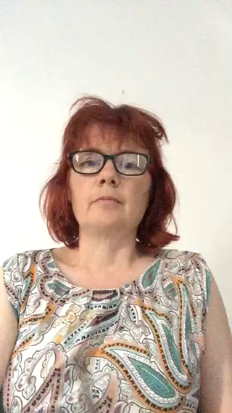

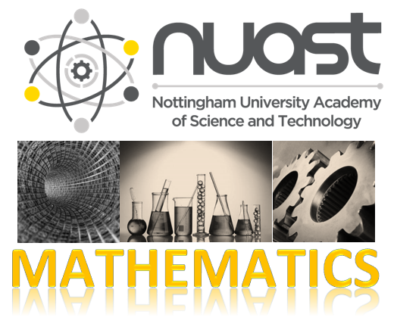
A Level Further Maths
Taking a step into the Unknown

Slide 2

Remember what is covered in AS/A level Mathematics?
Pure Mathematics (66%)
methods and techniques which underpin the study of all other areas of mathematics such as, proof, algebra, trigonometry, calculus, and vectors.
Statistics (17%)
statistical sampling, data presentation and probability leading to the study of statistical distributions
Mechanics (17%)
the study of the physical world, modelling the motion of objects and the forces acting on them.
If you study further maths, this content is covered at a faster pace to create more time to target challenging problems, and to spend longer on the harder topics in the further maths syllabus

Slide 3
Further Maths A Level Assessment
Paper 1: Core Pure Mathematics 1 & Paper 2: Core Pure Mathematics 2
Written examination: ( 2 × ) 1 hour and 30 minutes.
Content overview: Proof, Complex numbers, Matrices, Further algebra and functions, Further calculus, Further vectors, Polar coordinates, Hyperbolic functions, Differential equations
(50%)
Paper 3: TWO of the following THREE options
Further Mathematics Option 1
Written examination: 1 hour and 30 minutes.
Content overview: Further Statistics 1
Further Mathematics Option 2
Written examination: 1 hour and 30 minutes.
Content overview: Further Mechanics 1
Further Mathematics Option 3
Written examination: 1 hour and 30 minutes.
Content overview: Further Decision 1
(25%)
A more theoretical approach to studying statistical modelling
(25%)
The top choice of further mathematicians who also study Physics A Level
(25%)
A good choice for computer scientists, exploring algorithms

Slide 4
We asked year 12 further mathematicians what advice they would give to someone thinking about studying
A level further maths – they said:
Make sure you really like maths, because there’s an awful lot of it
Don’t feel bad about getting questions wrong
Don’t think that it is like half a subject – it isn’t
It’s more difficult than normal maths.
Think twice!
It’s a good subject to take, and it’s interesting and varied.
It certainly is a step up, and there will be some areas you find harder than others

Slide 5

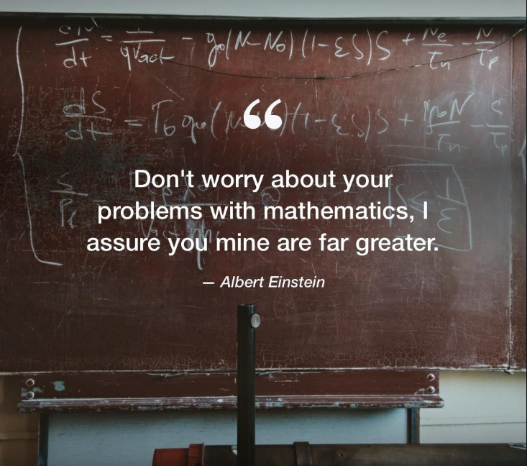

Slide 6



Connections ?
Find the roots α and β of x² + 7x + 12 = 0
What method did you use ?
Why does this occur ? ( x – α )( x – β ) = 0
Is there any direct connection between the roots and the quadratic equation you are solving?
$${(x+\frac{7}{2})}^{2}−\frac{49}{4}+12=0$$
$${(x+\frac{7}{2})}^{2}−\frac{1}{4}=0$$
$${(x+\frac{7}{2})}^{2}=\frac{1}{4}$$
$$x+\frac{7}{2}=±\frac{1}{2}$$
$$x=±\frac{1}{2}−\frac{7}{2}$$
$$x=−3, −4$$
x² + 7x + 12 = 0
$$∴\left(x+3\right)\left(x+4\right)=0$$
Which is true when:
$$x+3=0→x=−3$$
$$x+4=0→x=−4$$
$$x=\frac{−b±\sqrt{b^{2}−4ac}}{2a}$$
$=\frac{−7±\sqrt{7^{2}−4×1×12}}{2×1}$
$=\frac{−7±\sqrt{1}}{2}$
$x=−3, −4$

Slide 7
Connections ?
The roots of x³ + 9x² + 26x + 24 = 0 are α, β and γ
Can you see any direct connections with this polynomial and its roots ?
( x – α )( x – β )( x – γ ) = 0
The roots α, β and γ
are -2, -3 and -4
So how do these relate to the coefficients in the terms of the original cubic equation?
( x + 2 )( x + 3 )( x + 4 ) = 0
?
?
?

Slide 8
Connections ?
This is a quartic equation
The roots of x⁴ + 18x³ + 99x² + 202x + 120 = 0 are α, β, γ and δ
Anything that you can spot with quartic polynomials ?
( x – α )( x – β )( x – γ )( x – δ ) = 0
?

Slide 9
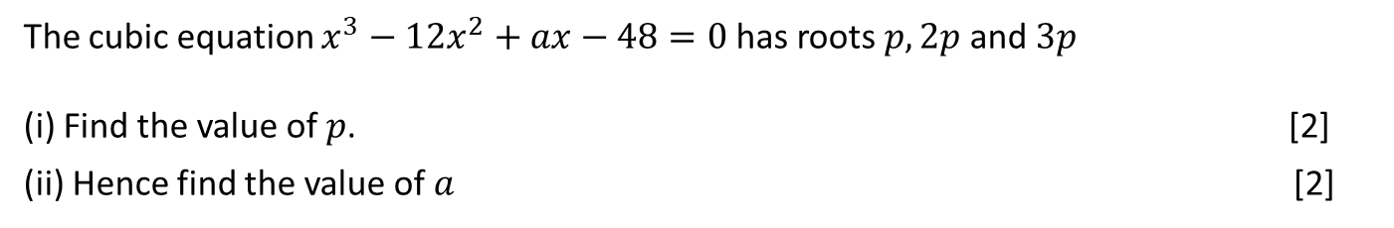
Connections
AS Further Core Pure Exam Question
The cubic equation $x^{3}−12x^{2}+ax−48=0$has roots $p, 2p$and $3p$
(i) Find the value of $p$. [2]
(ii) Hence find the value of $a$ [2]

Slide 10
Probably a little ambitious for now, but not too far away.
We study the properties of roots of polynomials before Christmas in year 12
Exam Question

Slide 11
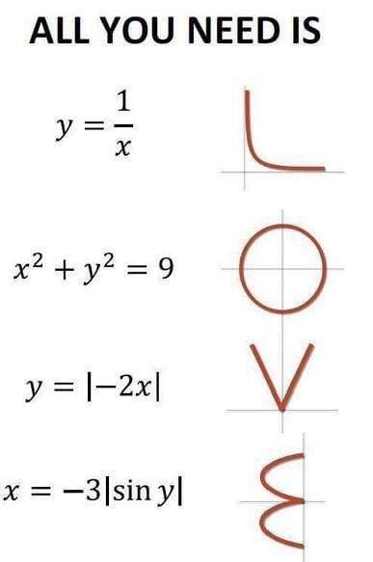
Further Maths visa checklist - are making the right choice ?
Each A level you study requires 4½ hours (6 lessons) of classroom study, backed up with roughly the same amount of time working independently in and out of school. Check that you are happy spending 18 hours a week studying maths.
The content of Further Maths A level is intended to build on those in the mathematics course and develop this content alongside introducing other new topics such as matrices, complex numbers, elastic collisions in mechanics, tests for the goodness of fit of a statistical model and algorithms based on optimisation criteria in decision maths. Do you have an appetite for expanding your mathematical horizons?
Further maths is only suitable for students who have secure enough maths skills to take on a higher level of challenge than the Maths A level. It is advisable to only consider studying the course if you achieve a minimum of grade 8 at GCSE.
Your Further Maths A level grade could be the key to accessing Oxbridge and other top university places in the study of Mathematics, Mathematical sciences or Economics. Do you already have an idea what you want to do after your sixth form studies.
for mathematics

