Slide 1

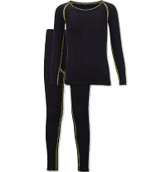
NUAST PE KIT
All students must have the following:
- Black NUAST PE top
- Plain black shorts
- Black football socks
- Shin pads
- Under Armour during the winter (optional)
FAILURE TO BRING THE CORRECT PE KIT WILL RESULT IN A C3 (Non-negotiable)
HOODIES/COLOURED COATS ARE NOT PART OF NUAST's PE KIT!!

